Slide 1


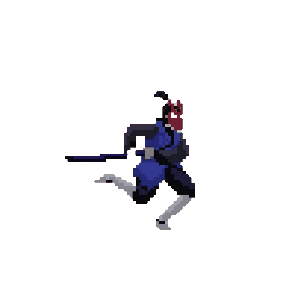

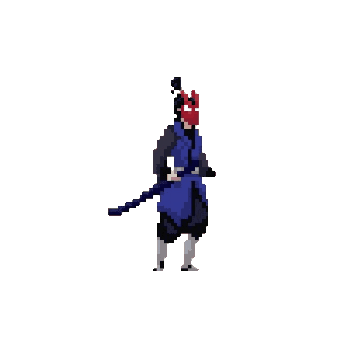

warrior’s
Wrath
START
Game presentation

Slide 2
warrior’s
Wrath
Game presentation
START

Slide 3





Table Of Contents
1
2
3
About the developers
Introduction to our game
Tools used to make the game

Slide 4
Table Of Contents
4
5
6
Features added to the game
problems we faced
conclusion

Slide 5
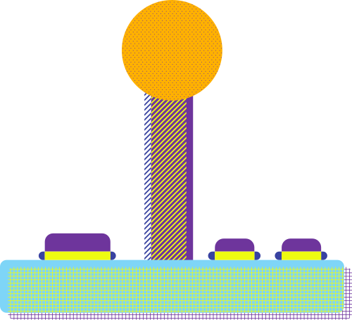


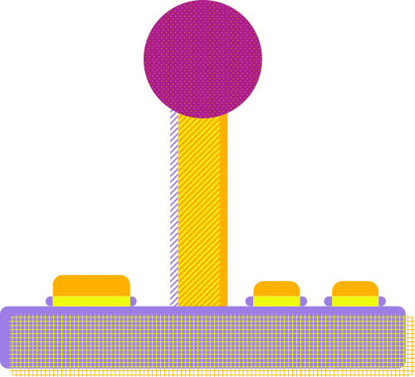
About the developers
1

Slide 6
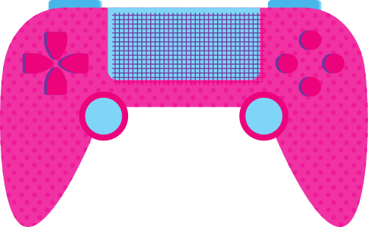
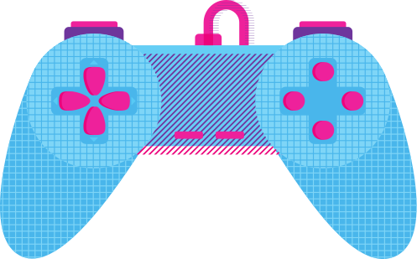
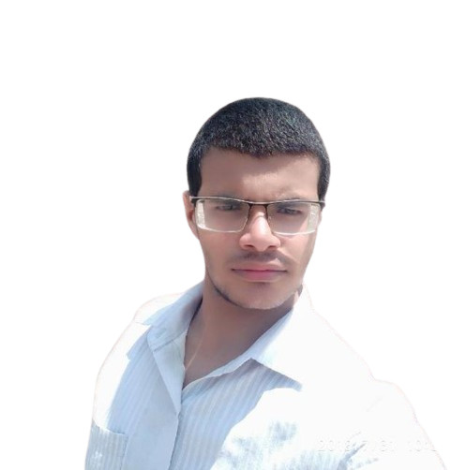
Under Supervision of
Dr:Hany Aly El-Ghaish
ENG:Ahmed Adel

Slide 7
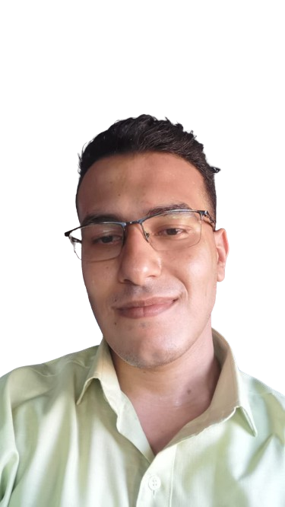

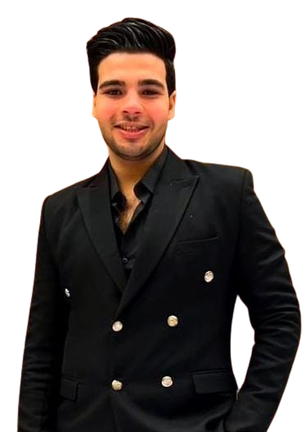
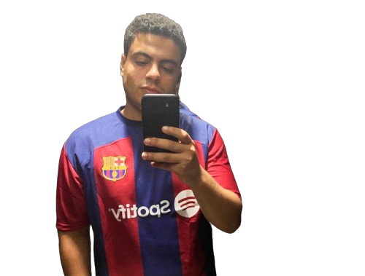
Our Team
Ahmad fathi
Hussain Amir
Hossam Elkhateeb
ibrahim Elgmmal

Slide 8

Introduction to our game
2

Slide 9



Warrior's Wrath
2D
2P game
Developed in PC
2 dimension game
Developed using python
Play with your friends
an exhilarating 2D fighting game
Developed using the powerful Pygame library

Slide 10

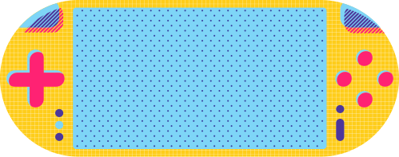
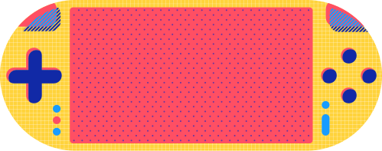
Tools used to make the game
3

Slide 11



For game developing
The cornerstone of "Warrior's Wrath" is the Pygame library, a robust set of Python modules specifically designed for game development. Pygame provides a versatile platform for creating 2D games, offering functionalities for handling graphics, input, and audio. With its simplicity and flexibility, Pygame empowers developers to bring their game ideas to life, making it an ideal choice for projects like "Warrior's Wrath."

Slide 12


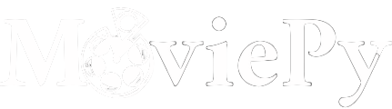
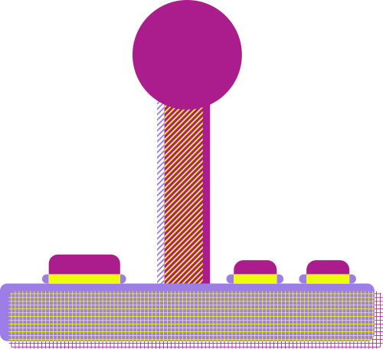
For the game intro
To kick off the gaming experience with a captivating introduction, MoviePy was employed. MoviePy is a Python library for video editing that seamlessly integrates with Pygame. This tool allowed the incorporation of an engaging intro video, setting the tone for the players and immersing them in the narrative of "Warrior's Wrath."
Studio
Entertainment
PRESENTS

Slide 13

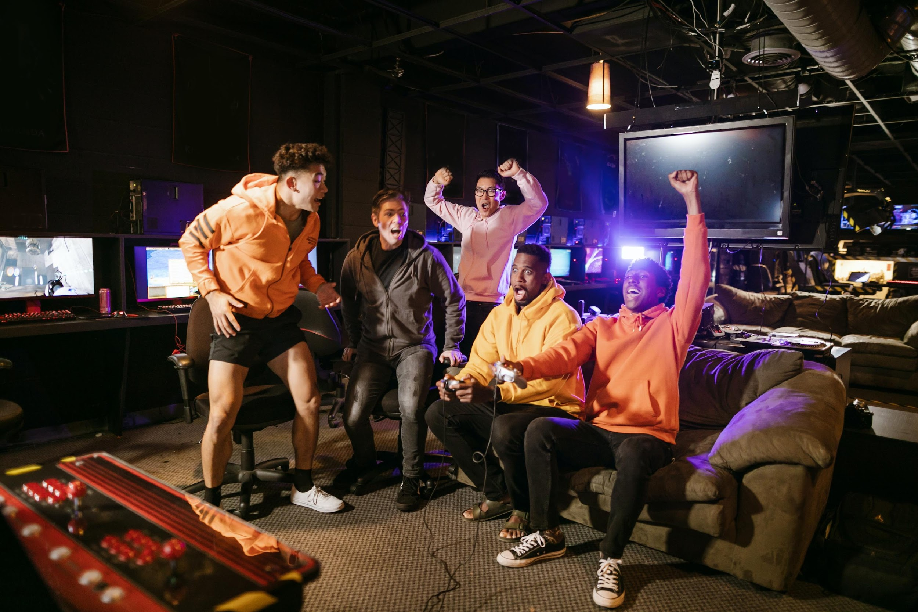

Programs used
Adobe photoshop
Filmora 13

Slide 14


Adobe photoshop
Programs used
Filmora 13
In the dynamic world of game development, creating a visually stunning and engaging introduction is a crucial element in capturing the player's attention. For "Warrior's Wrath," the intro video serves as a gateway to the game's immersive world, setting the stage for the epic battles that await. The tool of choice for this cinematic endeavor was Filmora 13, a versatile and user-friendly video editing software.

Slide 15
Programs used
Adobe photoshop
Filmora 13
In the realm of game development, visual elements play a critical role in conveying the essence and excitement of the gaming experience. For "Warrior's Wrath," the creation of dynamic and visually striking character animations was achieved through the powerful capabilities of Adobe Photoshop. This indispensable tool was employed to craft sprite sheets and meticulously adjust animation sizes, ensuring that each character in the game possesses a distinct and captivating presence.

Slide 16
Features added to the game
4

Slide 17
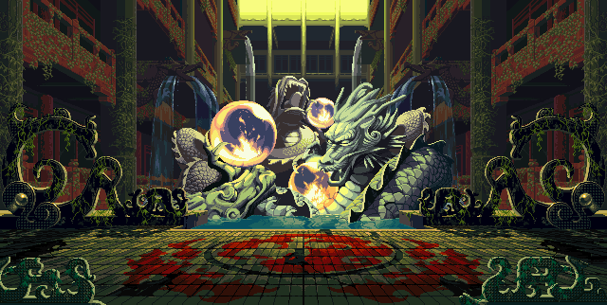



1- game menu
Warrior’s Wrath
start
How to play
Quit

Slide 18
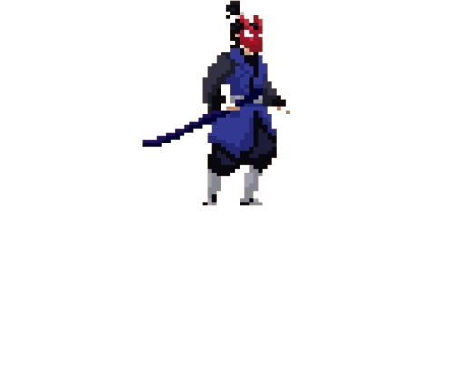
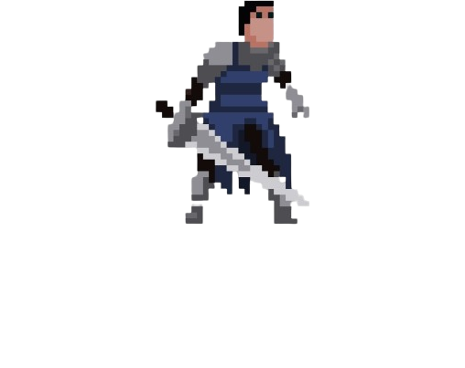
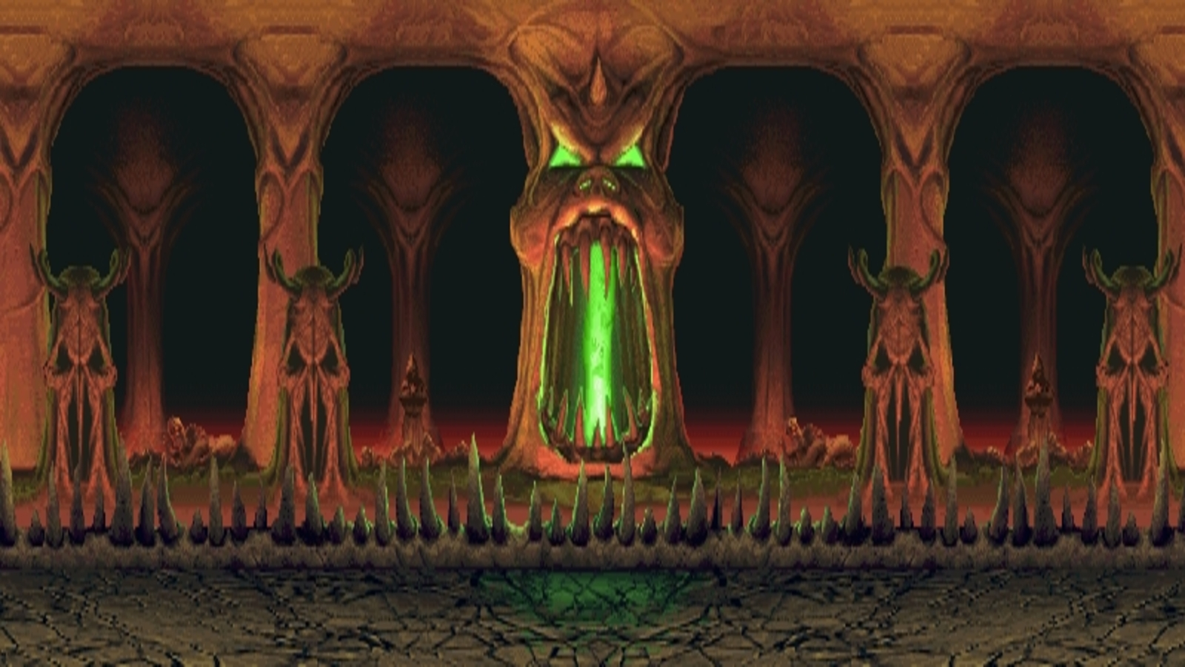
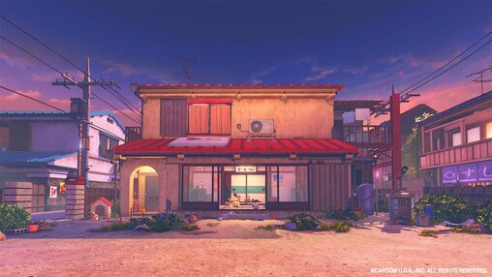
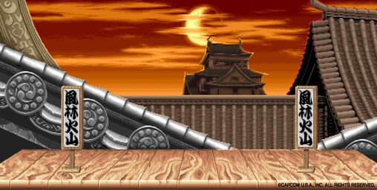
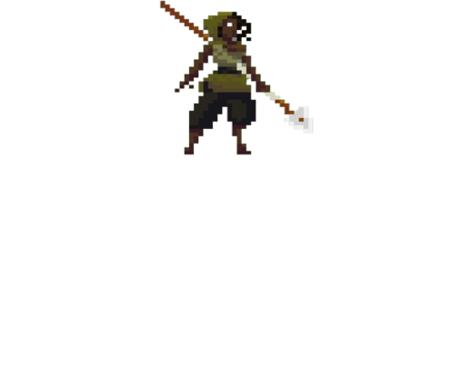
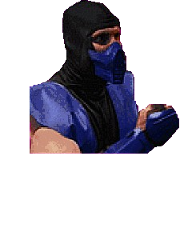
2- ability to choose the field
Choose your Field
The Hood
China Town
Soul chamber

Slide 19
3- ability to choose favorite fighter
Choose your Fighters
Samurai
warrior
Women Hunter
Sub zero

Slide 20
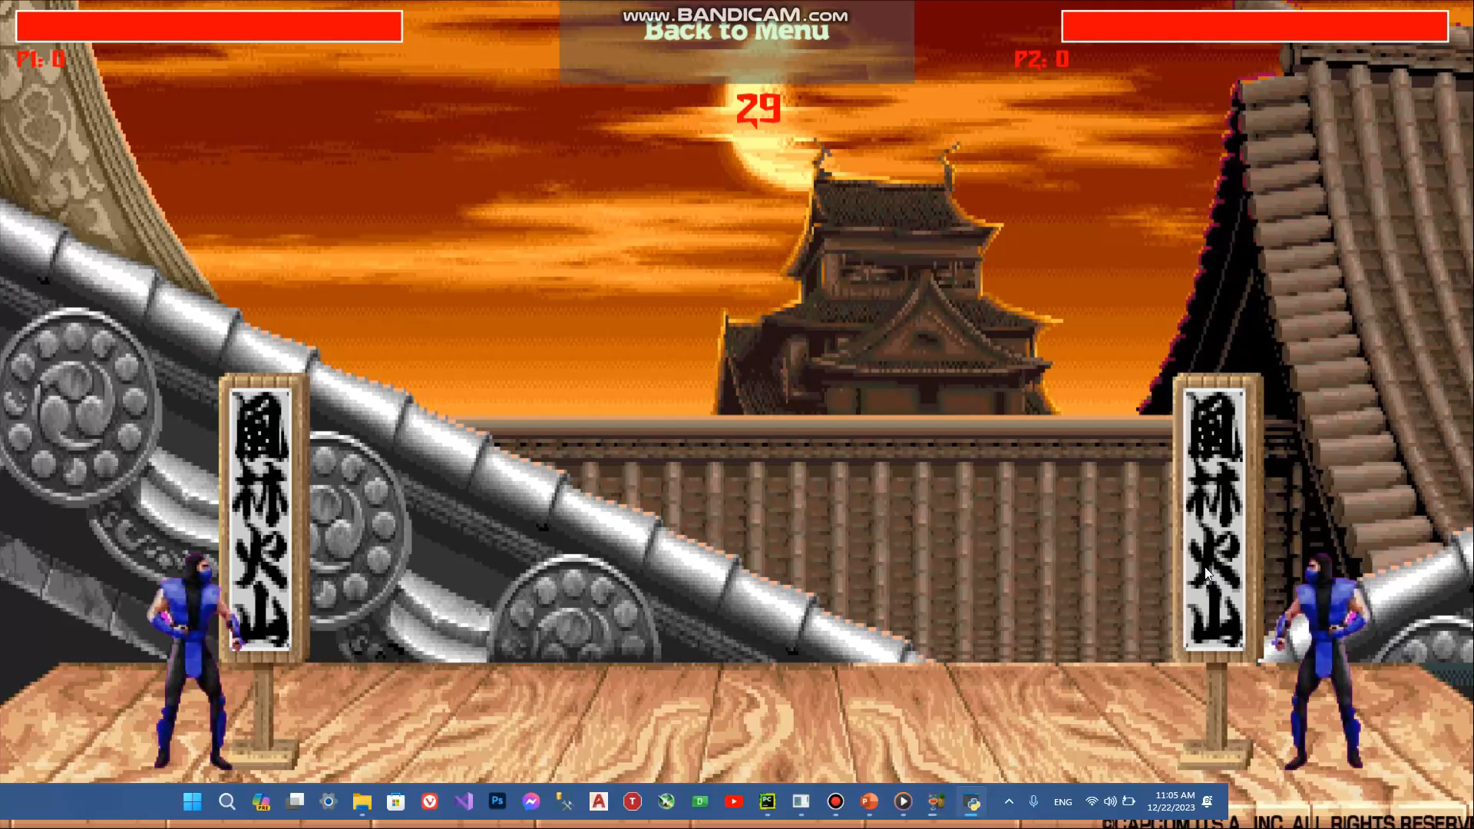

Slide 21
4- Timer added

Slide 22
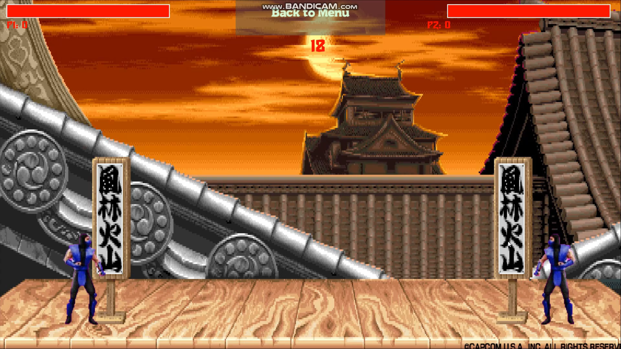
5- pause menu added

Slide 23


problems we faced
5

Slide 24
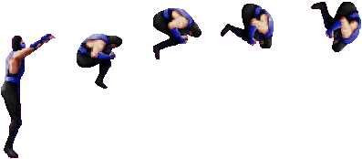
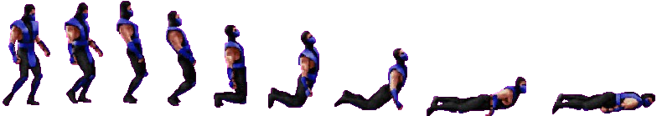
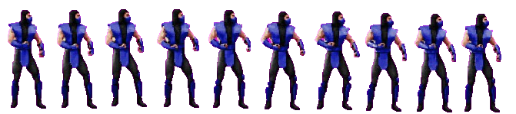
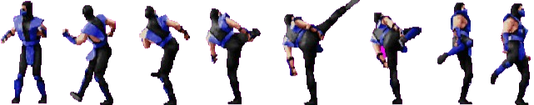
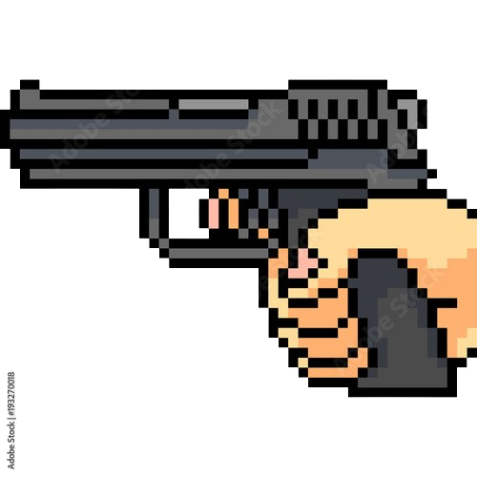
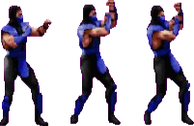
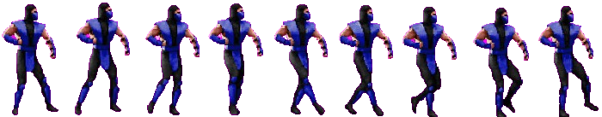
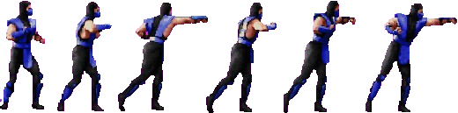
1- Combine each animation to one sprite sheet

Slide 25
1- Combine each animation to one sprite sheet

Slide 26
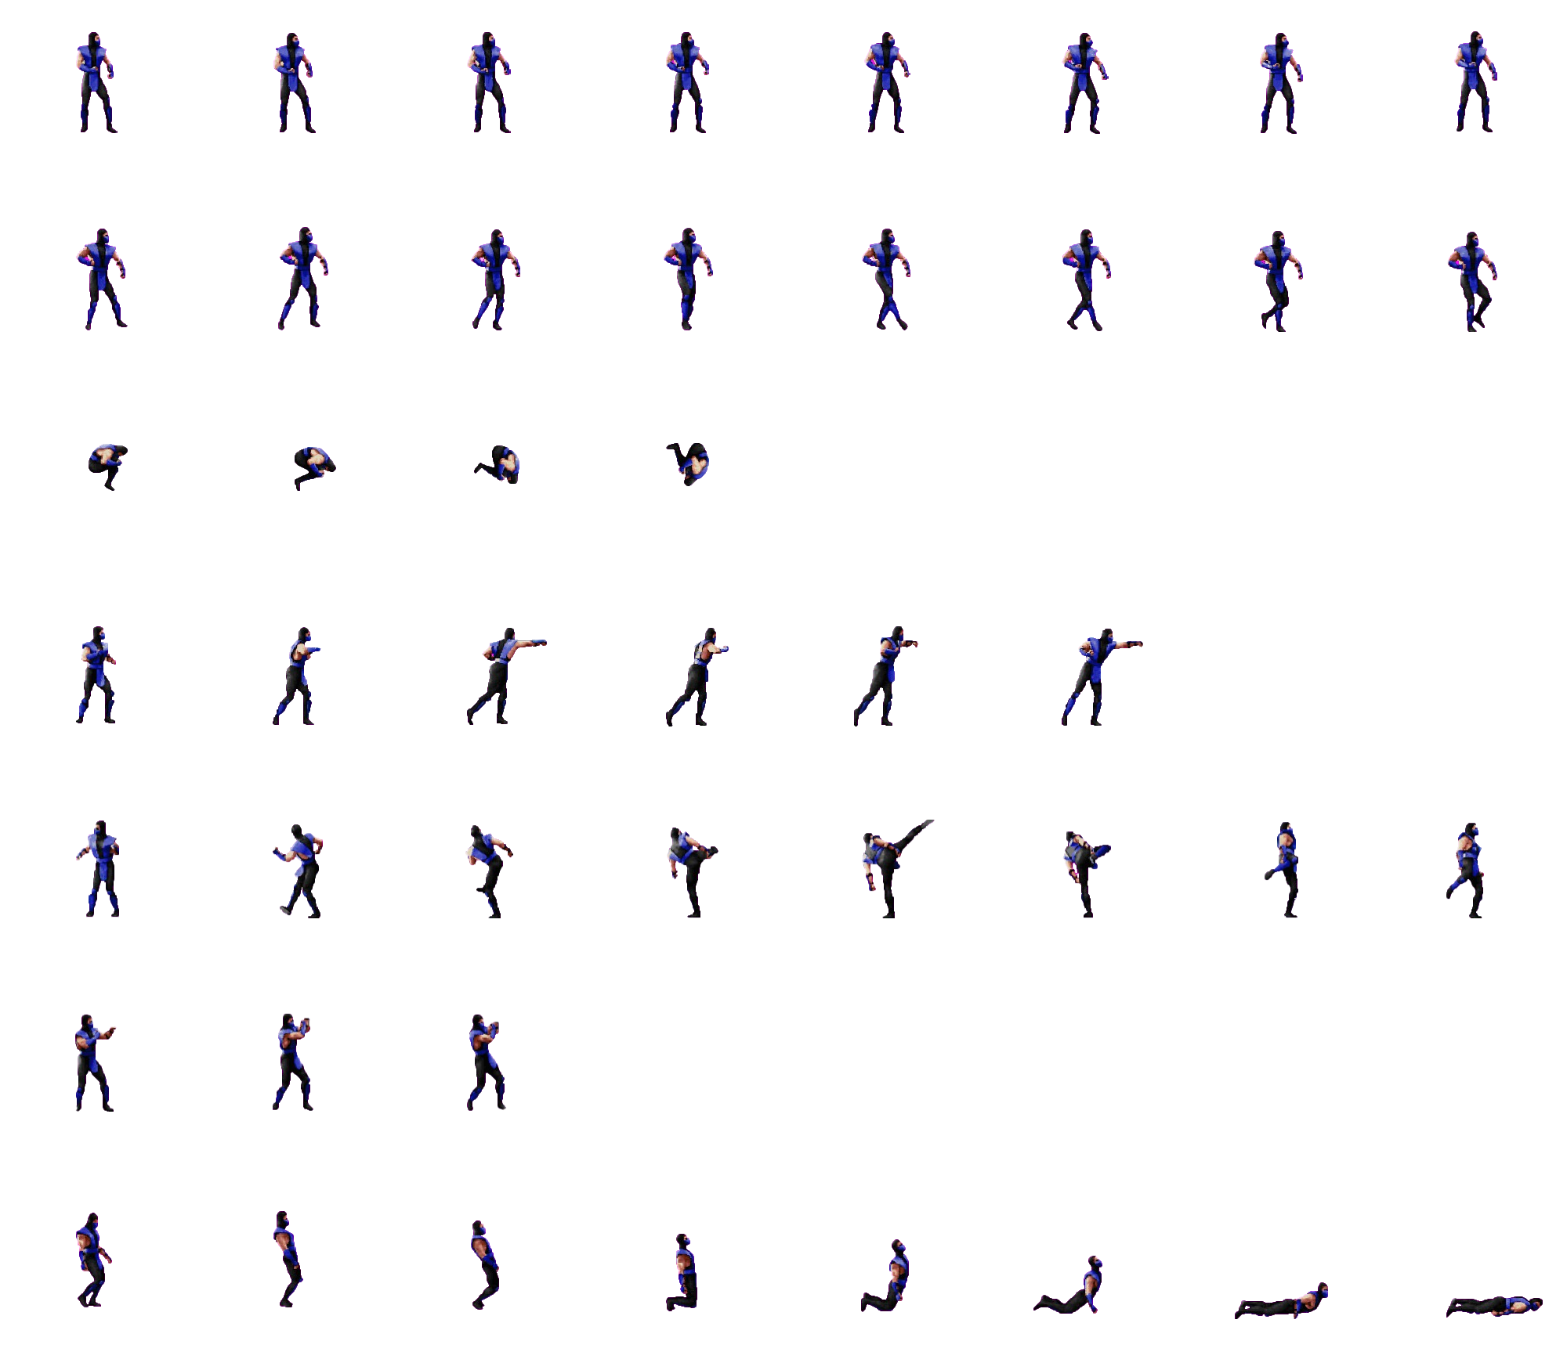
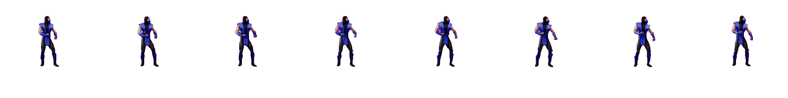
2- determine the “fighter”_SIZE value
2000 pixel
Sprite sheet
1750 pixel

Slide 27
2- determine the “fighter”_SIZE value
2000 pixel
2000 pixel
1
2
3
4
5
6
7
8
8
÷
==
250

Slide 28
1- determine the “fighter”_SIZE value

Slide 29
1- determine the “fighter”_SIZE value
20$
30$
300$
MONTHLY
MONTHLY
YEARLY
Add a feature
Add a feature
Add a feature
Add a feature
Add a feature
Add a feature

Slide 30
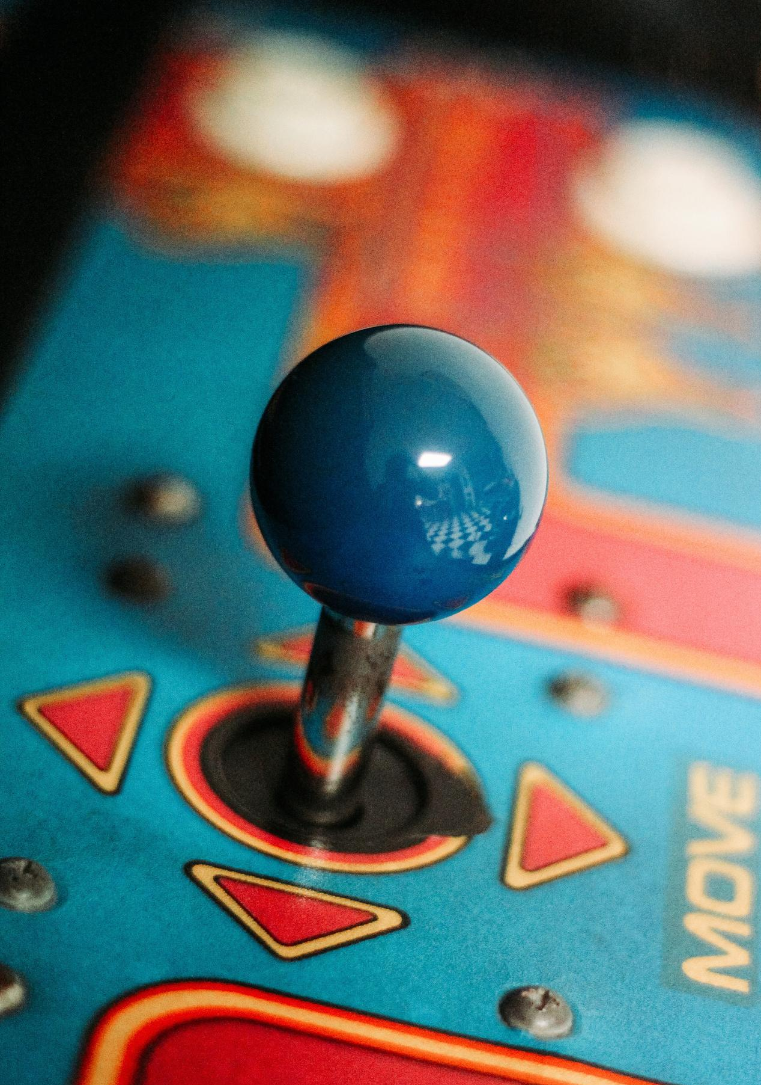

Our History
Presentations are communication tools that can be used as demonstrations, lectures, speeches, reports, and more. It is mostly presented before an audience.

Slide 31
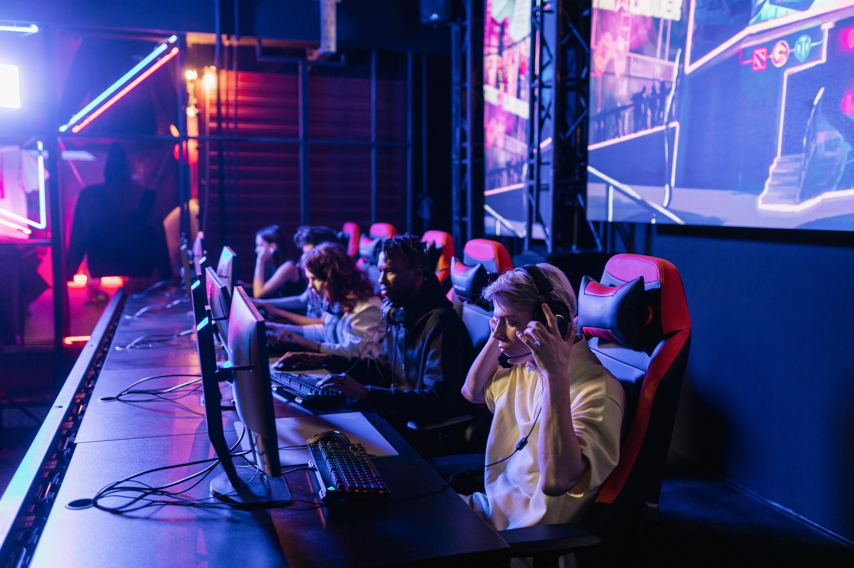

Write an original statement or inspiring quote
— Include a credit, citation, or supporting message

Slide 32


Our Founder
Name Surname
Presentations are communication tools that can be used as demonstrations, lectures, speeches, reports, and more. It is mostly presented before an audience.

Slide 33




Testimonials
Client name
Client name
Client name
Elaborate on what you want to discuss.
Elaborate on what you want to discuss.
Elaborate on what you want to discuss.

Slide 34

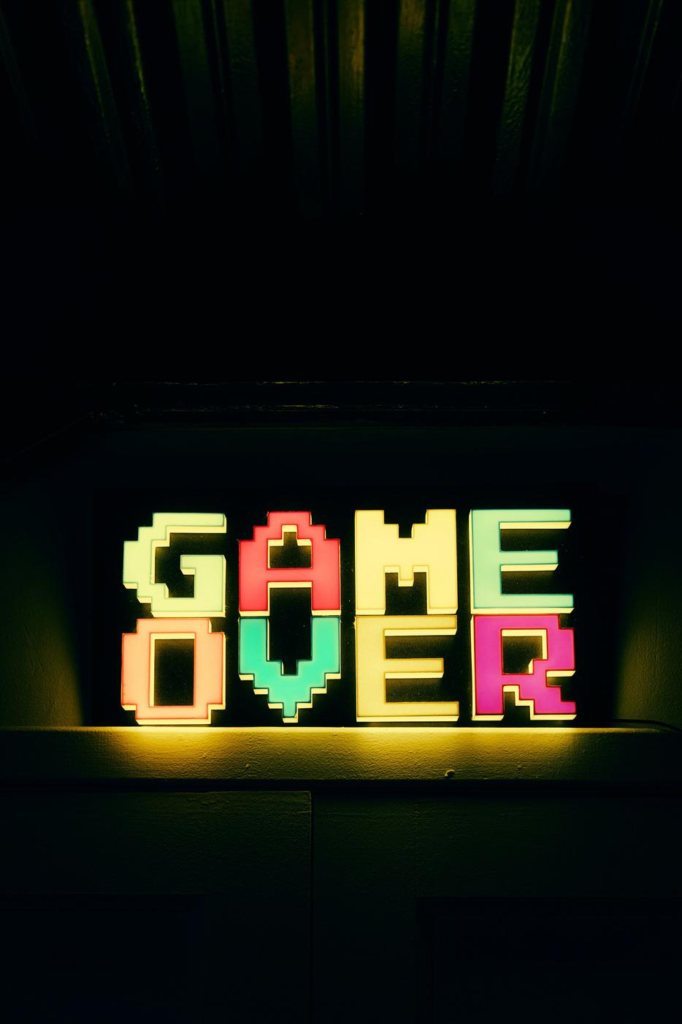
Thank you!
Write a closing statement or call-to-action here.

Slide 35
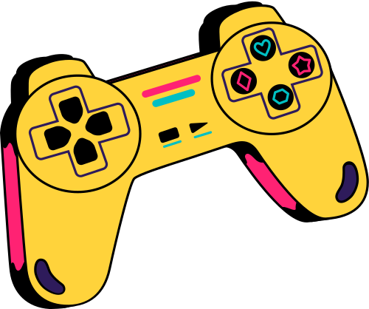


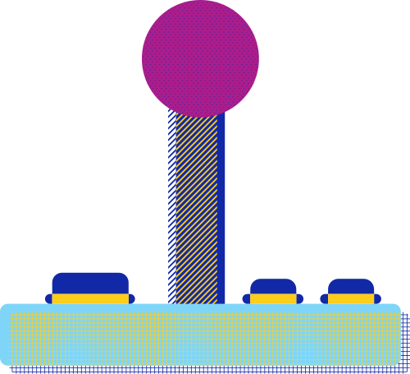










Resource
Page
Use these design resources in your Canva Presentation.
You can find these fonts online too. Happy designing!
Don't forget to delete this page
before presenting.
This presentation template uses the following free fonts:
Titles: Black Ops One, Disket Mono, Yeseva One
Headers: Black Ops One, Disket Mono
Body Copy: Stadio Now Monolinea
START

Slide 36


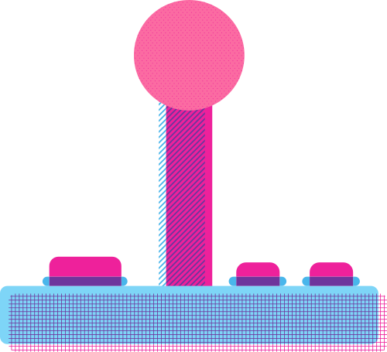
Credits
This presentation template is free for everyone to use thanks to the following:
SlidesCarnival for the presentation template
Pexels for the photos
Happy designing!

